Slide 1
Section 1.6: Minimum Spanning Trees
Math for Liberal Studies

Slide 2
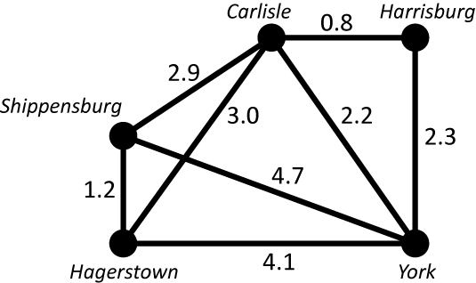
A Different Kind of Problem
A cable company wants to set up a small network in the local area
This graph shows the cost of connecting each pair of cities

Slide 3
A Different Kind of Problem
However, we don’t need all of these connections to make sure that each city is connected to the network

Slide 4
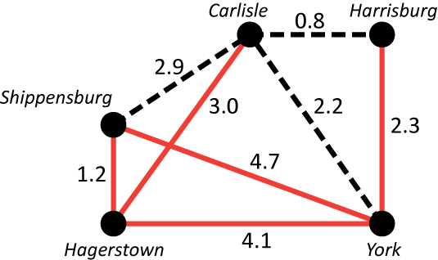
A Different Kind of Problem
For example, if we only build these connections, we can still send a signal along the network from any city to any other
The problem is to find the cheapest way to do this

Slide 5
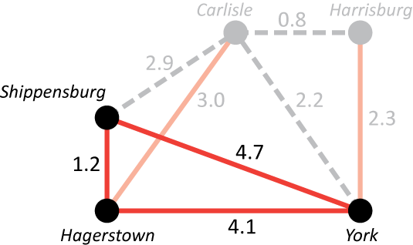
No Need for Circuits
We don’t need all three of these edges to make sure that these three cities are connected
We can omit any one of these from our network and everything is still connected

Slide 6
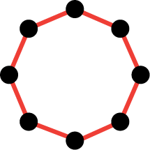
No Need for Circuits
In fact, if we ever have a circuit in our network…

Slide 7
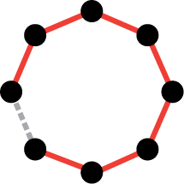
No Need for Circuits
… we can delete any one of the edges in the circuit and we would still be able to get from any vertex in the circuit to any other

Slide 8
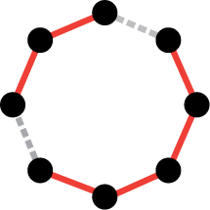
No Need for Circuits
But if we delete two of these edges, we don’t have a connected network any longer

Slide 9
Minimum Spanning Tree
The solution we are looking for is called a minimum spanning tree
minimum: lowest total cost
spanning: connects all of the vertices to each other through the network
tree: no circuits

Slide 10
Kruskal’s Algorithm
Named for Joseph Kruskal (1928 - )
Another heuristic algorithm
Basic idea: Use cheap edges before expensive ones
Guaranteed to find the minimum spanning tree

Slide 11
Kruskal’s Algorithm
Start with none of the edges being part of the solution
Then add edges one at a time, starting with the cheapest edge…
…but don’t add an edge if it would create a circuit
Keep adding edges until every vertex is connected to the network

Slide 12
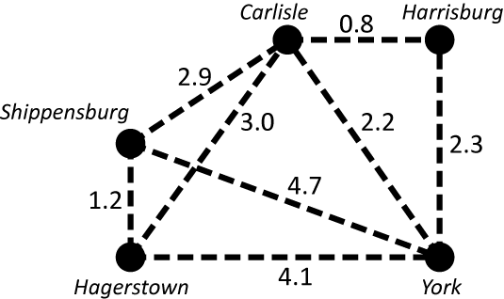
Kruskal’s Algorithm
We start with none of the edges included in our network

Slide 13
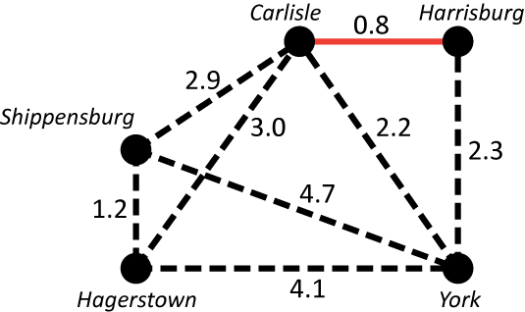
Kruskal’s Algorithm
The cheapest edge is Carlisle to Harrisburg

Slide 14
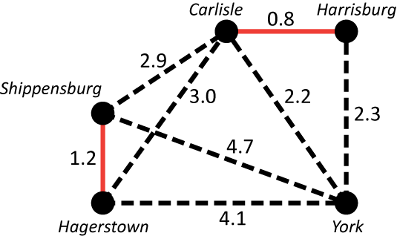
Kruskal’s Algorithm
Next is Shippensburg to Hagerstown
Notice that the edges we add don’t have to be connected (yet)

Slide 15
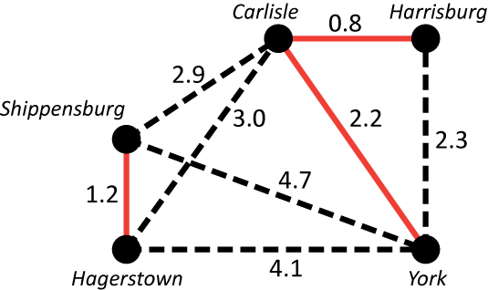
Kruskal’s Algorithm
Next is Carlisle to York
Notice that now every city is connected to some other city, but we still don’t have one connected network

Slide 16
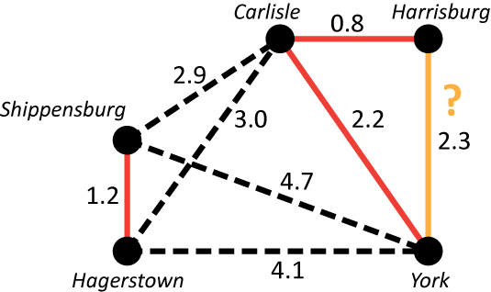
Kruskal’s Algorithm
Next is Harrisburg to York
Adding this edge would create a circuit, so we leave it out and move on

Slide 17
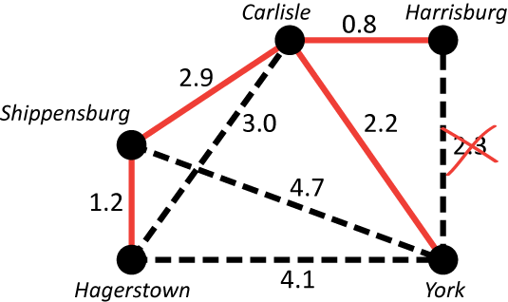
Kruskal’s Algorithm
The next cheapest edge is Shippensburg to Carlisle

Slide 18
Kruskal’s Algorithm
At this point we have connected all of our vertices to our network, so we stop

Slide 19
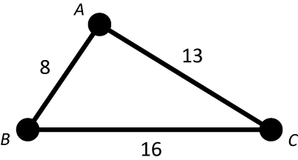
Minimum Distances
As another example, consider this graph

Slide 20
Minimum Distances
Kruskal’s algorithm easily gives us the minimum spanning tree for this graph

Slide 21
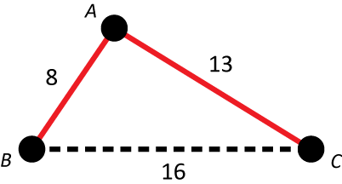
Minimum Distances
Kruskal’s algorithm easily gives us the minimum spanning tree for this graph
This tree has a cost of 21

Slide 22
Minimum Distances
Is this the cheapest way to connect all three cities to a network?

Slide 23
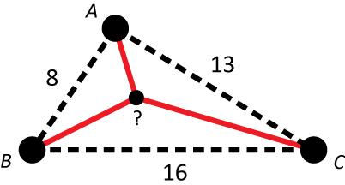
Minimum Distances
Perhaps there is a fourth point in the center that we could use to get a lower total

Slide 24
Minimum Distances
If the numbers represent distance (rather than cost, which can vary in other ways), then the point that yields the minimum total distance is called the geometric median

Slide 25
Minimum Distances
In this case, the geometric median gives a total distance of approximately 20.6, which is slightly lower than the result from Kruskal’s algorithm

